Slide 1
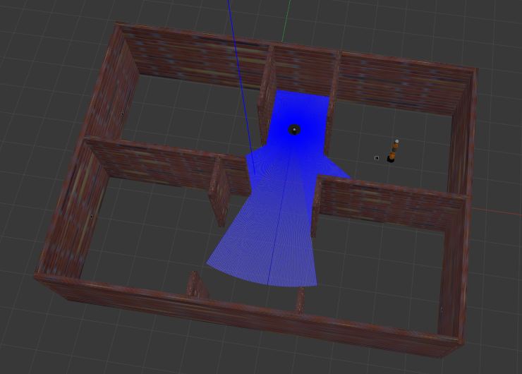
ROBOTICS LAB PROJECT
Multi-Robot System
with Turtlebot3_burger and Kuka_iiwa
Miryam Pirozzi P38000063

Slide 2
INTRODUCTION
Multi-robot systems can be implemented in a large variety of fields, from the industrial one to service robotics and beyond. In this case study a simple multi-robot system has been created: in order to make it as much realistic as possible, a world as been created in order do mimic an industrial environment in which one robot navigates and the other one performs a manipulation.
Modularity is one of the main goals of this thecnical project, in order to make it easy to read and understand. Moreover, it has been made generic enough to be suitably changed based on the application.

Slide 3
PRESENTATION’S KEY POINTS
Packages and Folders;
Robots’ models and Gazebo world;
Sensors;
Offline map;
Marker Detection with ArUco;
Navigation stack and ArUco launch files;
Move and Search;
Inverse Kinematic Control;
Client/Server approach;
Results and Conclusions;
Possible improvements.

Slide 4
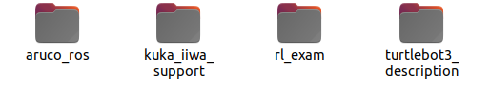
Packages and folders
aruco_ros: provided by Pal Robotics. Through this package it was possible to create the «all_aruco.launch» launch file.
kuka:_iiwa_support: provided by professor Cacace. Through this package it was possible to extract the urdf of the Kuka Iiwa. Moreover, I used the meshes of iiwa7 and the controllers in the .yaml file.
turtlebot3_description: provided by ROBOTIS. The xacro file and meshes have been taken from this package.
rl_exam: this is the project package. First of all, here we will find all the launch files, the nodes that need to be executed, all the models of the fiducial markers and of the gazebo world. Moreover, it also include the Rviz configuration that has been properly saved in order to be ready to use. The «maps» folder contains the .pgm of the map and its .yaml file. An «srv» folder has been create in order to implement a Client/Server approach for the communication. The CMakeLists.txt file has been modified accordingly.

Slide 5
Robots’ models and Gazebo world
The Gazebo world shown below has been saved in the «world» folder of my package. It has been created in the editor section of Gazebo using a suitable planimetry found on the internet.
Next, two launch files have been created to spawn the two robots.
Those two launch files have been later included in the main one, by carefully using two different namespaces in order not to create conflicts.
Then, the offline map has been created and saved using the map server. By doing this, it was possible to include the Rviz node into the main launch file.

Slide 6
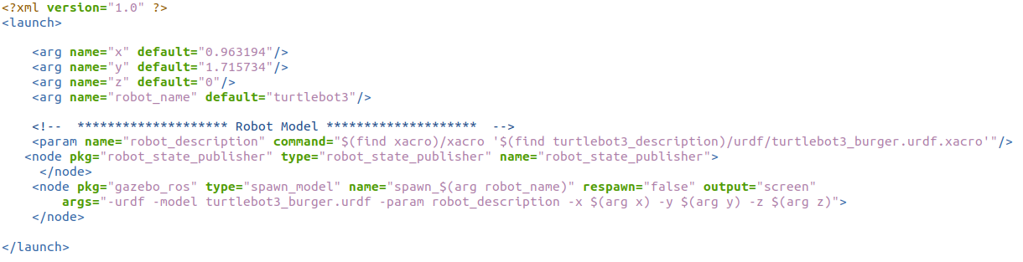
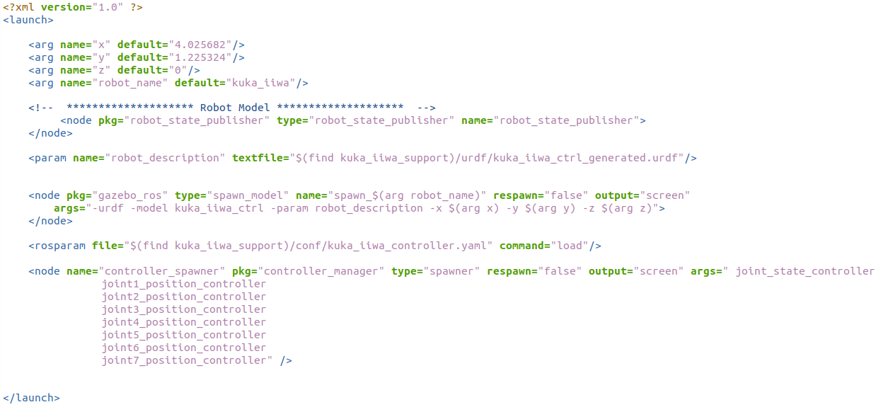
Robots’ models and Gazebo world

Slide 7
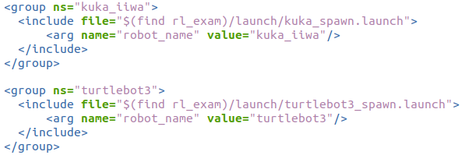
Robots’ models and Gazebo world
Employing two different namespaces was mandatory in order not to create conflicts between the two robot_state_publishers, sensors and topics.

Slide 8
Sensors
Before creating and then saving the map, sensors needed to be implemented (it has been done for both the robots in this phase even if only the lidar was necessary for the mapping).
STEP 1: adding the lidar to the turtlebot, since it must be able to detect obstacles and evaluate their distance from the sensor itself.
STEP 2: adding the camera to the turtlebot, since for the purpose of this projects it must be able to detect fiducial markers placed on the walls.
STEP 3: adding the camera to the kuka, since it must be able to detect the marker placed on the floor in close proximity.

Slide 9
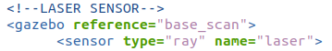
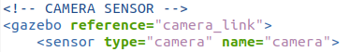
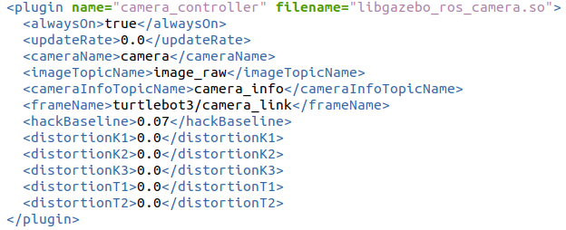
Sensors (turtlebot3)

Slide 10
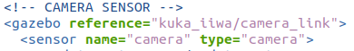
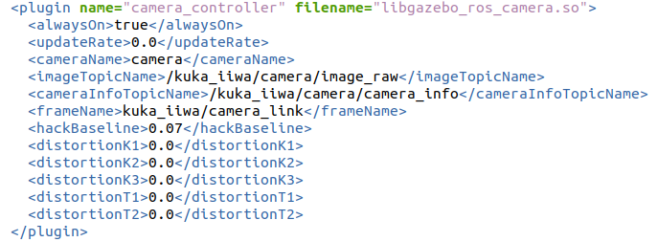
Sensors (kuka_iiwa)

Slide 11
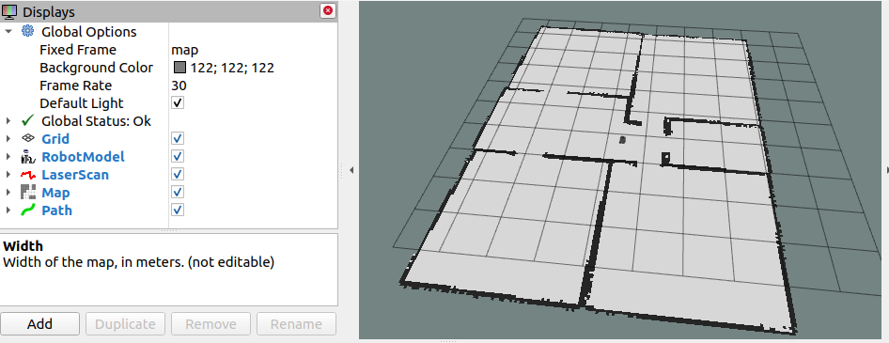
Offline map
Once the turtlebot was equipped with its lidar sensor, it was possible to implement the SLAM with Gmapping in order to create the environment map. The robot has been moved thanks to the «key_teleop» package that we have been provided with during the course (by suitably changing the namespace of the topic on which the velocity command is given).

Slide 12
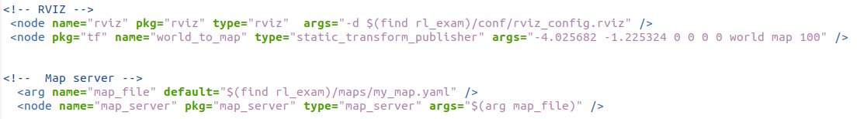
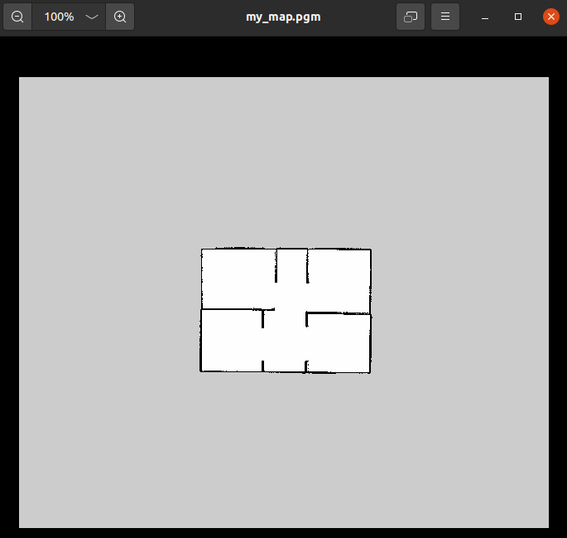
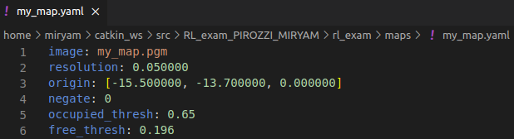
Offline map
After having navigated the entire environment, the map has been saved using the map-server package, and uploaded within the main launch file.

Slide 13
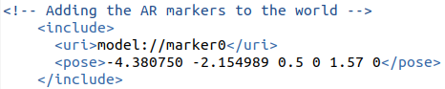
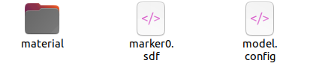
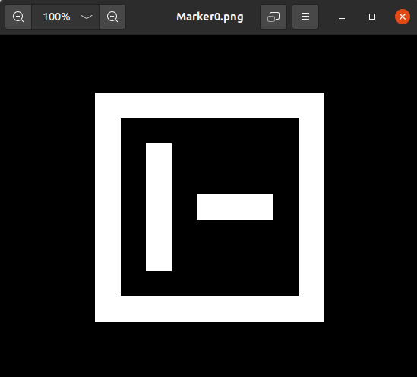
Marker Detection with ArUco
Markers have been generated through the «gazebo_fiducial_generator» package found on GitHub and have been later added to the world file as follows:
Where «marker0» is a sub-folder included in the «models» folder of my package, and contains the following elements:
Whose corresponding .png image is the following one:
Three markers have been placed on the walls of three rooms, while the fourth one has been placed on the floor, near the kuka.

Slide 14
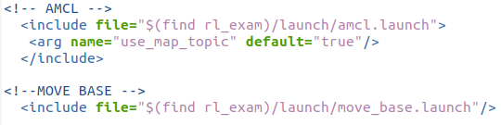
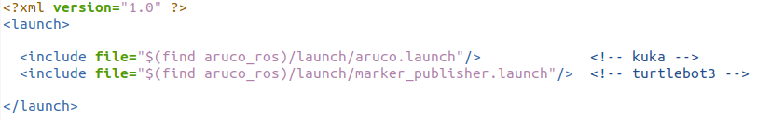
Navigation stack and ArUco launch files
For the purpose of this project, the turtlebot must be able to navigate a known environment, therefore the navigation stack has been implemented in the main launch file «spawn_robots_and_world» as follows:
The «all_aruco.launch» from the «aruco_ros» package is then delegated to the marker detection part, both for the kuka and the turtlebot.

Slide 15
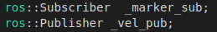
Move and Search
The «move_and_search.cpp» node deals with the turtlebot’s task, and is placed in the src forlder of my package.
STEP 1: Let the user choose the item to pick.
STEP 2: Move to all three rooms.
STEP 3: Search for the desired item.
STEP 4: Reach the target position near kuka.
Publishers and Subscribers
Sets up a subscriber to the /aruco_marker_publisher/markers topic
Used to publish the velocity command in function rotate()

Slide 16
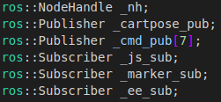
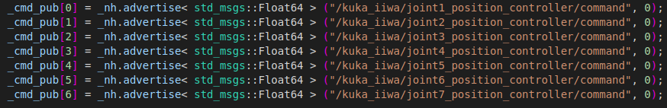
Inverse Kinematic Control
The node dealing with kuka iiwa is called ‘kuka_invkin_ctrl.cpp’. The main source file has been shared by the professor during our course, and it has been properly modified.
STEP 1: Adapt the code to my robot model.
STEP 2: Start from desired pose and search for the marker.
STEP 3: Try approaching the centre of marker.
Publishers and Subscribers
Used to publish the end-effector pose
Used to publish the control joints’ control inputs
Used to retrieve the joints’ states
Used to create a new subscriber on the topic related to the marker near kuka

Slide 17
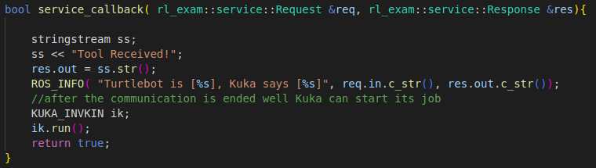
Client/Server approach
After having implemented and tested the two source files separately, their communication has been made possible through a service client/server approach, by basically imagining the kuka_invkin_ctrl node as the server waiting for the client, represented by the move_and_search node.
Server

Slide 18
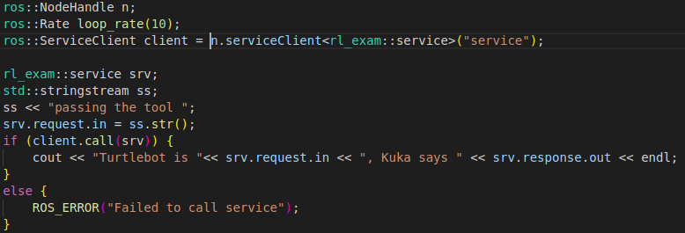
Client/Server approach
Client
The client has been implemented in the move() method, when the turtlebot reaches the goal position next to the kuka.

Slide 19
Results and Conclusions
Once all the modules of the project have been properly implemented, the project itself can be run by following few steps:
STEP 1: launching the ‘spawn_robots_and_world.launch’ file in order to open the map in Rviz with the robot models and spawning the world and robots in Gazebo.
STEP 2: launching the ‘all_aruco.launch’ file from the aruco_ros package in order to publish the data relative to the markers’ detection from both the robots.
STEP 3: opening the rqt_image_view tool in order to visualize the content of different topics of interest.
STEP 4: running the server node first (kuka_invkin_ctrl), and then the client one (move_and_search) .

Slide 20
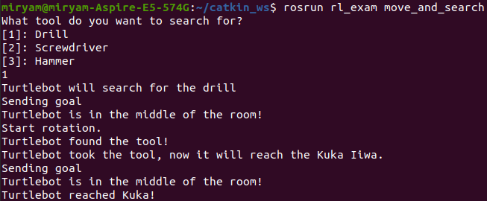
Results and Conclusions
First, the terminal of the client node will show the following output:
Subsequently, the server node receives the communication from the client and starts the manipulation and detection:

Slide 21
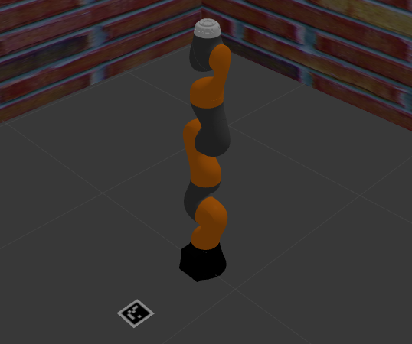
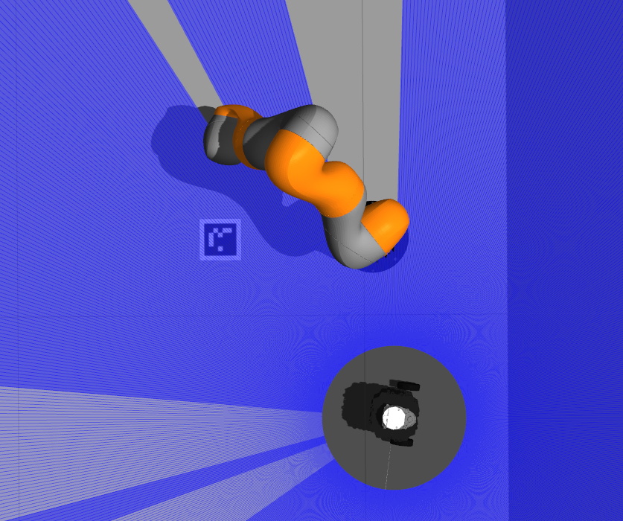
Results and Conclusions
In the following images a before and after of the communication to the kuka will be shown:
Before
After

Slide 22
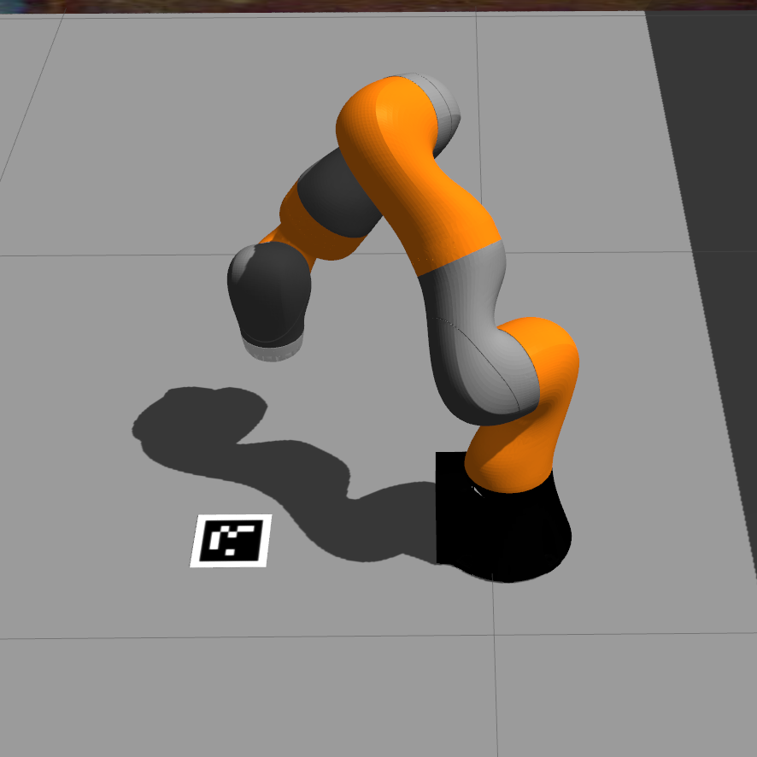
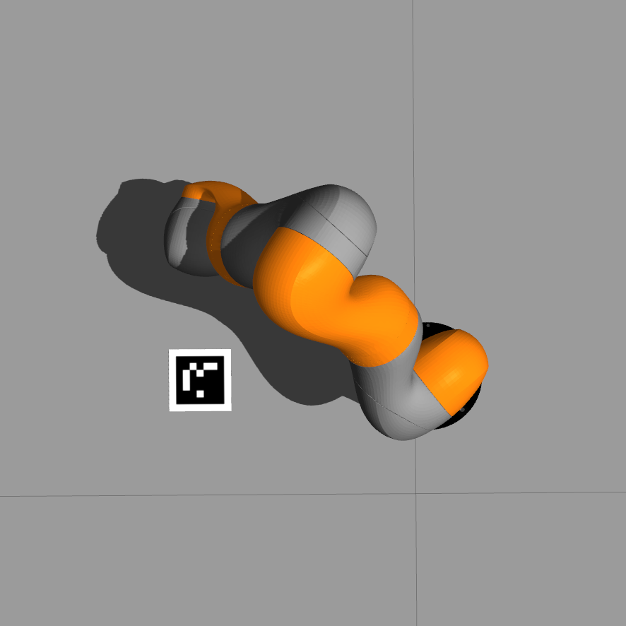
Possible improvements
One main issue regarding the execution is that the kuka manipulator does not get to the very center of the marker, as it incorrectly detects the frame attached to the marker.

Slide 23
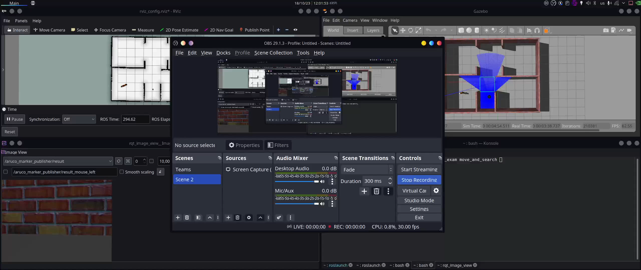
Video with focus on turtlebot’s navigation

Slide 24
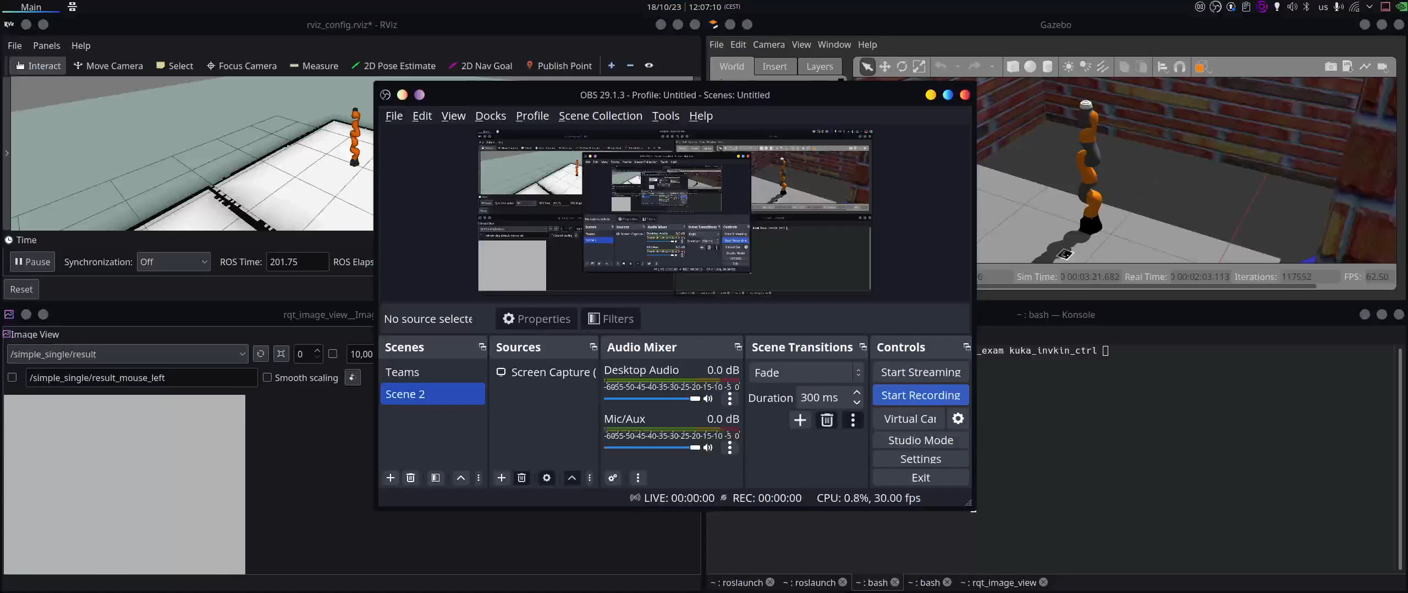
Video with focus on kuka’s manipulation

Slide 25
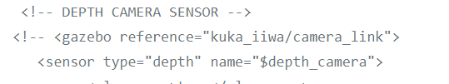
Possible improvements
One possible solution that I have tried is to substitute the camera with a depth camera sensor:
Unfortunately, this solution led to an incorrect kinematic inversion, so the final decision was to keep the camera sensor and to accept the positioning error of the kuka manipulator.
Surely, some work can be done to make the kinematic inversion work even with the depth camera sensor, which represents a further improvement that could be performed on this project.

Slide 26
THANK YOU FOR YOUR ATTENTION

